Slide 1
REGIONAL INJURIES
Dr.salini Chandran
DEPT: OF FM & TOXICOLOGY
SKHMC;KULASEKHARAM

Slide 2
Mechanical Injuries can assume varying significance depending upon the location & structure of organ involved
Let us discuss some common injuries in a region wise manner

Slide 3
HEAD
Mechanical force can injure-
Scalp
Skull
Meninges
Brain
Or related vessels
Separately or in combination

Slide 4
SCALP
Abrasions -Relatively uncommon due to the presence of hair
Incised wounds-Bleed profusely but healing is rapid
Lacerated wounds-Incised looking wounds-bleed profusely
Contusions
Punctured wounds

Slide 5
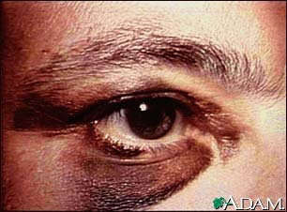
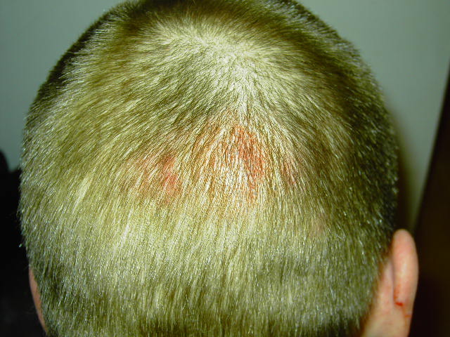
Bruise of scalp
Contusion of scalp can settle around orbit
Black eye- example of ectopic contusion

Slide 6
SKULL
Due to
Direct impact
Indirect impact
If the impact is more than the elasticity of skull –Fracture results
Force of 5 foot pounds can fracture the skull
Also depends on relative thickness & strength of the bone in different regions

Slide 7
Classification-Skull Fractures
Fissured
Ring
Comminuted-With or without depression
Gutter
Pond
Diastatic (sutural)
Cut
Perforating

Slide 8
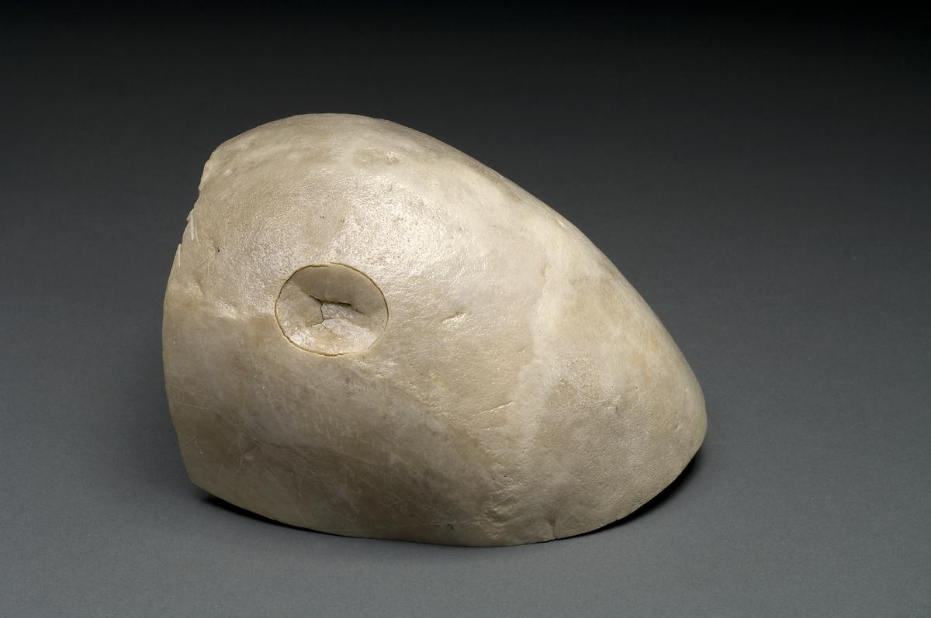
Signature fracture

Slide 9
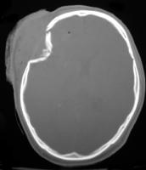
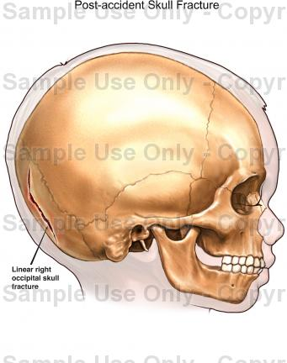
FISSURED FRACTURE
DEPRESSED FRACTURE (CT)

Slide 10
MENINGES
Any of the three meninges can be torn by edges of fragmented pieces of skull or by penetrating objects
Pia & arachnoid can also be ruptured due to accumulation of blood from beneath

Slide 11
FACE
Injuries of face which causes permanent disfiguration represent grievous hurt
Permanent disfiguration may be due to scar or keloid formation or due to derangement or loss of tissues

Slide 12
MOUTH AND NOSE
Abrasions & contusions in or around mouth
suggests forceful opening or forceful closure
Superficial lacerations of lips
Blunt impact
Occasionally the lips may be cut off or bitten off as a revengeful act

Slide 13
Blunt trauma as in the case of fall or blow can cause injuries to the bone & teeth
Injuries causing fracture of jaw bones or nasal bones or fracture/dislocation of teeth constitute grievous hurt
If the cribriform plate of ethmoid bone is fractured it causes anosmia
Partial detachment of nasal mucous membrane leading to nasal bleedingcan occur after blunt trauma to head even without direct involvement of nose

Slide 14
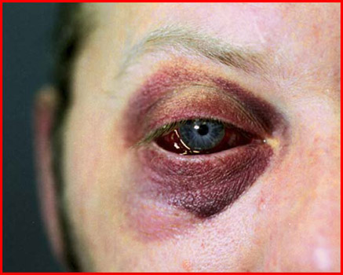
EYES & EARS
“Black eye”- Accumulation of blood around the eyeball and eyelids which manifests as darkish discolouration around the eyes
Occurs directly from blunt trauma or as an ectopic bruise

Slide 15
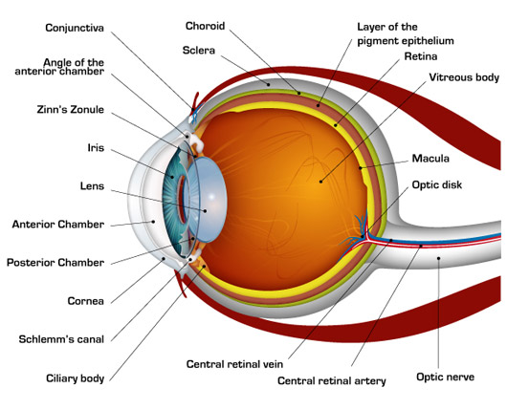
Trauma can cause injury to cornea iris,lens and the retina or haemorrhage into the anterior chamber
Retinal detachment & traumatic cataract can be sequelae of trauma
Penetrating injuries to the eyes can lead to evisceration
Infections of eyeballs can spread to the brain and can lead to death bycavernous sinus thrombosis or meningitis

Slide 16
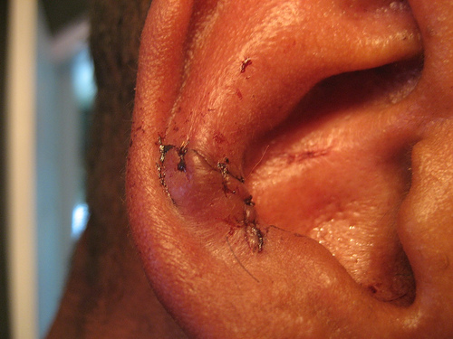
Injury leading to permanent loss of vision of either eye or loss of hearing of either ear constitutes grievous hurt
Ears can be cut orchopped off or bitten away as an act of revenge or to forcibly remove earrings
Abrasions ,contusions or lacerations can occur to one or both ears,from accidents of different kinds
A hard blow to the ear can can rupture the tympanic membrane leading to deafness
Ear Injury

Slide 17
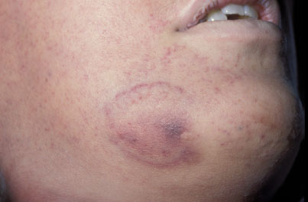
CHEEK
Abrasions contusions & lacerations can occur from blunt trauma
Malar bones can fracture from direct or indirect violence
The fracture line in such cases is usually horizontal & involvesthe posterior third of the malar skeleton
Bite marks can result from assault or from ‘love bite’

Slide 18
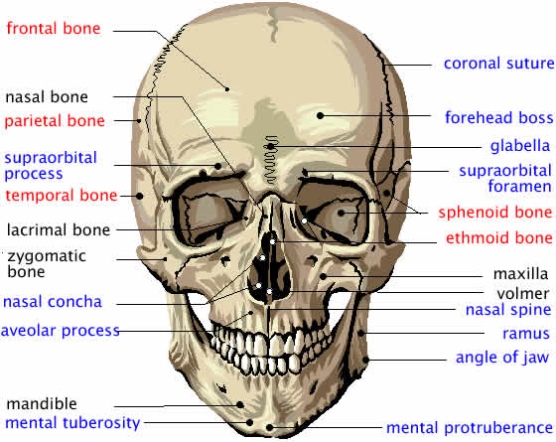
JAWS
Fractures of mandible-commonly vertical- from direct trauma
A blow to the point of chin – can cause aring fracture to the base of skull
Blunt injury to the face can cause comminuted fracture of maxilla
Blood and dislocated teeth from fracture of jaw bone may be ingested or inhaled causing death by choking

Slide 19
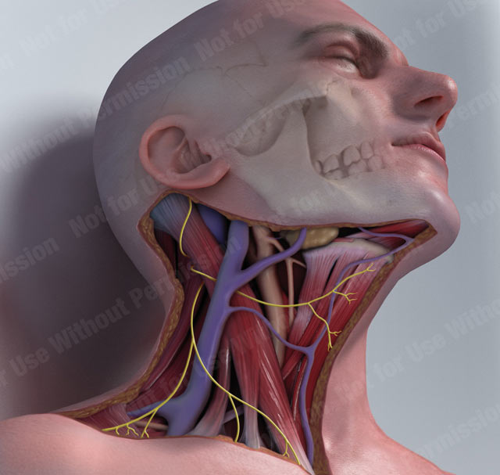
NECK
Superficial wounds –not much bleeding
Penetrating wounds, incised wounds and deep lacerations produce copious bleeding due to the severance of carotid & jugular vessels

Slide 20
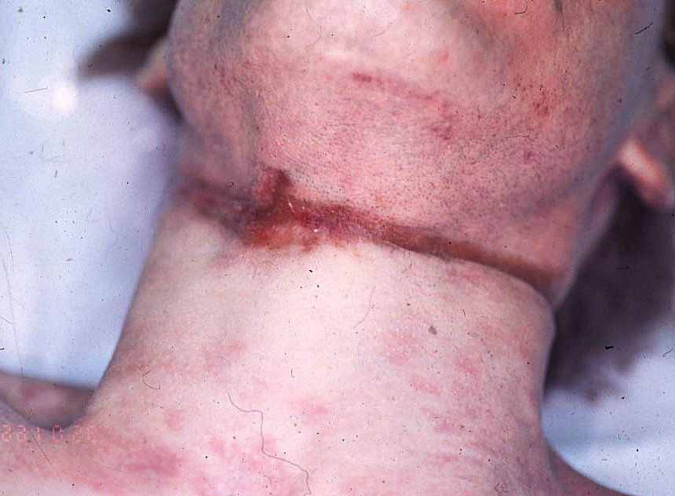
Direct impact on hypopharynx can fracture the thyroid cartilage
Hyoid bone fracture blunt impacting force
blunt constricting force
Scratch abrasions in the form of nail marks indicate throttling
Pressure abrasions in the form of ligature mark indicates hanging or strangulation
LIGATURE MARK ON NECK

Slide 21
A blow on the front of neck can precipitate vagal inhibition which can result in sudden unconsciousness or death
Injuries on larynx & trachea can cause choking due to the blood
Laryngeal oedema is another complication of trauma
Incised wounds (Cut throat wounds) can be suicidal ,homicidal or accidental
Air embolism can cause sudden death in cut throat wounds

Slide 22
Air from wounded respiratory passages enters into the subcutaneous space
resulting in subcutaneous emphysema which may dissect down to the mediastinum leading to mediastinal emphysema and subsequent respiratory obstruction
The dome of pleura if penetrated through the neck can cause pneumothorax
Aphonia & hoarseness results if recurrent laryngeal nerve gets involved
Injury to brachial plexus can cause loss of function of the arm or hand
Speech is impossible in cases of open wounds of larynx & trachea below the level of vocal cords

Slide 23
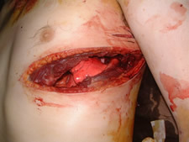
CHEST
External & internal injuries of neck often coexist,though this need not be the case always
Impact of a considerable nature can give rise to alternate compression and decompression
Leads to initial congestion followed by laceration and haemorrhage due to rupture of lung alveoli
Injuries of the chest may be penetrating (open) or non- penetrating (closed)

Slide 24
CHEST WALL
Rib fractures occur in the region of maximum stretch
AP compression of chest causes fractures in the mid-axillary line & side to side compression causes fractures in the necks and costochondral junctions
The 4th & 8th ribs are the commonest ribs to fracture
Multiple rib fractures
Localised blunt trauma with reasonable force can involve any rib at any site

Slide 25
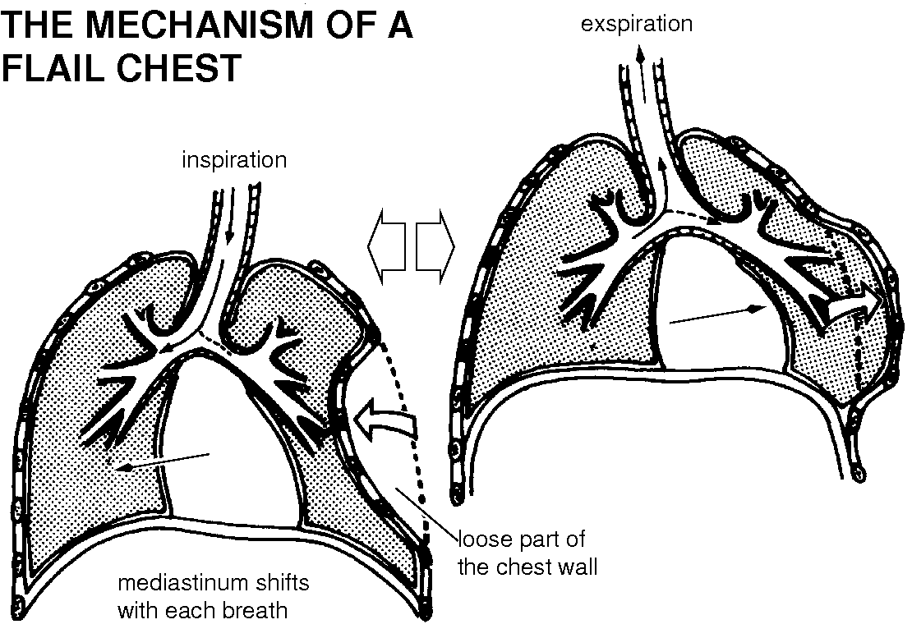
Multiple rib fractures can give rise to flail-chest or stove in chest with paradoxical respiration

Slide 26
Fractured ends of ribs sometimes project outwards or inwards causing injuries to the overlying or underlying membranes tissues muscles or organs
Lacerated wounds involving chest wall & parietal pleura can lead to open pneumothorax
Osteoporosis ,osteomalacia and secondary malignancy are associated with fragility and easy fracture of ribs
3rd to 5th ribs of left side are often involved in external cardiac massage
They usually occur at costochondral junctions

Slide 27
Sternum does not fracture easily
It can fracture from direct local force as in the case of an impact with the steering wheel of a vehicle in a collision accident
Usually near the manubrio-sternal junction
Usually the fractures are transverse
Severe blows on the chest wall may produce concussion of the chest ,shock and even deatheven in the absence of structural damage to viscera
Breasts are common sites for wounds originating from a sexual act eg nail marks

Slide 28
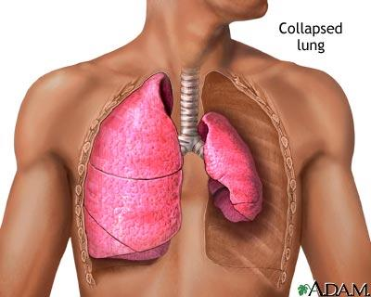
LUNGS & HEART
Get injured by blunt or penetrating forces
Especially susceptible to contusions or lacerations
Traumatic cavitation of lungs
Injury to lungs result in pneumothorax,haemothorax,haemopneumothorax,interstitial & subcutaneous emphysema,etc
An injured lung may collapse

Slide 29
Heart
The right ventricle is more prone to injuries, since it forms major part of the anterior surface of the heart
If the injury is obliquely placed bleeding is less
Penetrating injuries lead to haemopericardium and subsequent haemothorax
Blunt injuries cause the pericardium to remain intact but the heart may rupture leading to development of haemopericardium
Rupture of the heart is more common in young individuals
Rapid accumulation of 250-350cc of blood can lead to cardiac tamponade
Right atrium is cmmonly involved in traumatic rupture

Slide 30
Cardiac tamponade
Progressive limiting of the pumping action of heart and eventual cardiac arrest is called cardiac tamponade
In the old blunt injuries can precipitate MI
A diseased heart can rupture with even trivial trauma
Blunt injuries can cause contusion of heart walls septae,and papillary muscles
In case of pericardial tear a portion of heart can herniate through it and get compressed- strangulation of the heart

Slide 31
Oesophagus, trachea ,bronchi bronchioles aorta, venacavae, and pulmonary arteries can be injured by blunt or penetrating trauma
Rupture of aorta usually occurs at the junction of the arch with the descending part
Ruptures of oesophagus usually occur in the form of longitudinal splits
The most common site of rupture of diaphragm due to blunt trauma is at or around the central tendon of the left side
Herniation of abdominal viscera into the chest can occur

Slide 32
ABDOMEN & PELVIS
The ant: abdominal wall easily yields to pressure,and hence usually escapes unscathed from blunt trauma
Contusion of anterior abdominal wall is very rare,except in run over injuries from vehicles
Abrasions occur quite commonly over the ant: abdominal wall

Slide 33
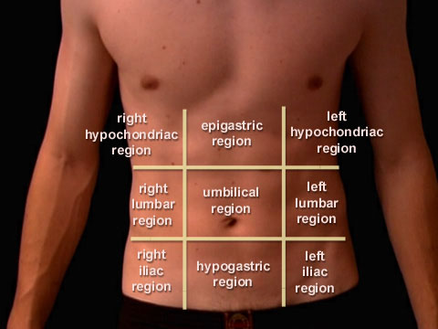
Blunt trauma can result in extensive injuries of abdominal viscera even in the absence of any external injury
The actual total depth of a penetrating wound of the abdomen can be exaggerated due to the yielding nature of the ant: abdominal wall
A blow on the abdomen can cause death due to vagal inhibition

Slide 34
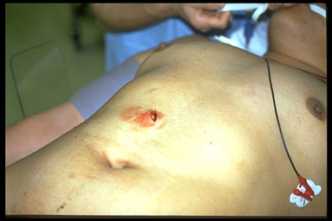
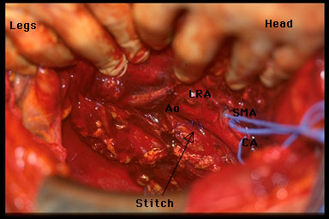
Viscera
Any of the abdominal & pelvic viscera can get injured due to blunt or penetrating trauma
In severe crushing force , there can be sudden shock, haemoperitonium or peritonitis
Stab injury to abdomen causing haemoperitonium

Slide 35
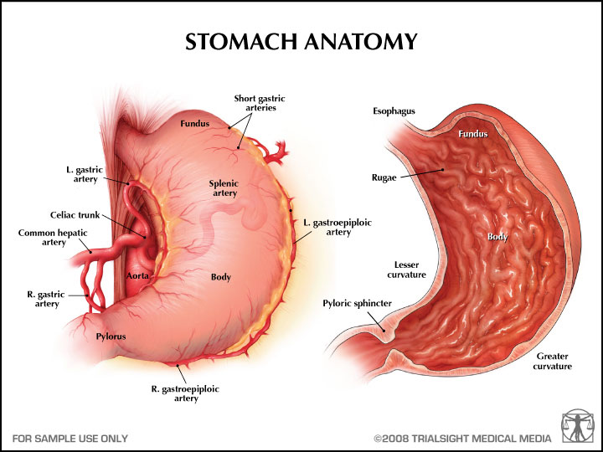
Oesophagus, Stomach & Intestines
Rupture of stomach usually occurs in the pyloric region along the lesser curvature
Stomach can be contused from blunt trauma and delayed rupture can occur

Slide 36
Oesophagomalacia & gastric malacia may take place in some persons hours or days after sustaining cerebral trauma
This is believed to be brought about by neurogenic stimuli arising from the parasympatholytic centre of the diencephalon
Intestines can rupture from blunt force either at the point of impact,or some distance away
The former shows clean edges, while the latter has a ragged appearance
Transverse rupture of mesentery can lead to gangrene of a segment of intestine by transecting the supplying artery

Slide 37
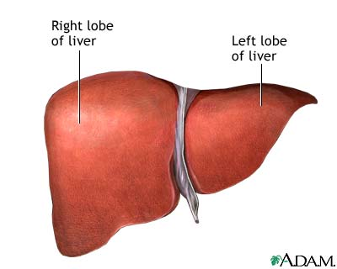
Liver & Spleen
Liver is very vulnerable to injury
Rupture mainly occurs over anterior and inferior surfacesof the right lobe
The direction of rupture depends upon the direction of pressure
Hepatic ruptures can be transcapsular, subcapsular or central
Ribs can also injure the liver
Ruptured liver usually causes substantial haemoperitonium

Slide 38
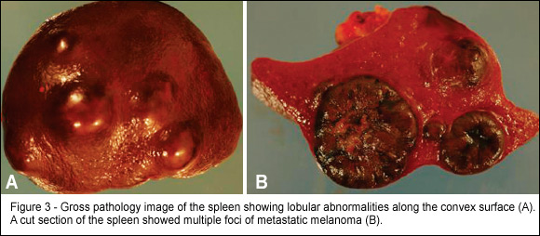
Spleen
Easily injured from trauma either from blunt or penetrating injury
Degree of damage varies
Beeding is profuse
Malarial or leukaemic spleen ruptures easily
Such a spleen can rupture due to strong muscular contractions of coughing or defecation
Diseased spleen

Slide 39
URINARY TRACT
Rupture of bladder often accompanies pelvic fractures
Shock ,bleeding, peritonitis & UTI are common complications
Urethra ruptures usually at the membraneous part due to pelvic fracture or application of blunt force
Female urethra may rupture during a violent act of rape
Falling astride a projecting object is a frequent cause for rupture of male urethra
Lacerations of the kidney can be transcapsular, subcapsular or transrenal

Slide 40
LIMBS
Any type of wound can occur
Direct & indirect trauma can cause different types of injury to muscles
Tetanus ,gas gangrene,and renal failure may follow
Muscles may sustain severe injuries although the skin looks intact
Thighs with intact skin can accommodate even upto 1 litre of blood ,which is fatal resulting from rupture of vessels due to a crushing force
Blunt injury to the limbs is extremely common, especially in traffic accidents
Even multiple superficial soft tissue injury due to blows or kicks can cause death, though the bones may be intact
Fracture of the femur or the bones of
lower leg from the impact of a vehicle against a pedestrian is called ‘Bumper fracture’
Ligaments can undergo avulsion
Defence wounds

Slide 41
GENITALIA
External genitalia can suffer different types of injuries especially related to violent sexual act or sexual jealousy
Squeezing of testicles can be fatal due to reflex cardiac inhibition
Criminal amputation of male genitalia can cause death due to bleeding
Attempted criminal abortion can can lead to injuries of female genitalia

Slide 42
VERTEBRAL COLUMN
Injuries to the vertebral column can be due to direct or indirect trauma which may or may not involve the spinal cord
Commonest site of traumatic damage is the lumbar vertebra
Spinal cord is rarely injured without associated fractures of the vertebral column

Slide 43
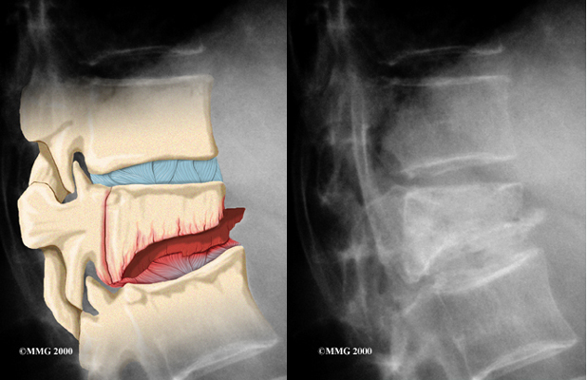
Fractures of the vertebra are of 3 types
1. Wedge compression fracture

Slide 44
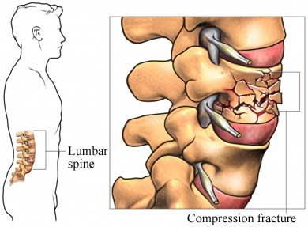
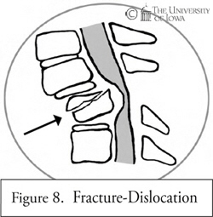
2. Comminuted fracture
3.

Slide 45
Whiplash Injury
Hyperflexion or hyperextension of neck can result in cervical vertebral column injury and is called ‘whiplash injury’
The symptoms may appear immediately or after several weeks
Common symptoms are dizziness, headaches, stiffness of neck, jaw, shoulder or arm ,nausea, diminished ability to bend, vomiting, blurred vision, ringing in ears, lack of concentration, memory loss, tiredness sleeplessness and irritability

Slide 46
Fatal contusion or laceration of the spinal cord can occur in whiplash injuries in the absence of any fracture to the vertebral column
Involvement of the cord above the level of 5th cervical vertebra can be fatal due to damage to phrenic nerve
Lower level involvement can cause quadriplegia
Quadriplegia, paraplegia and respiratory and urinary infections invariably follow vertebral column and spinal cord injuries
Sacral segment involvement can cause impotence in males

Slide 47
Railway spine
Blunt force over vertebral column can lead to concussion of spinal cord without visible injury to the vertebrae
This is called Railway spine due to its frequent occurrence in railway accidents
Commonest region affected is the lumbo-sacral spine resulting in paraplegia, bladder disturbances and impotence
Such concussion is spontaneously reversible, these abnormalities are only temporary

Slide 48
THANK YOU

